Slide 1
Impact of the Growth of Wind Energy on CCGT Heat Rates for ERCOT Plants: 2006-2016

Slide 2
I. Initial Exploratory Analysis

Slide 3
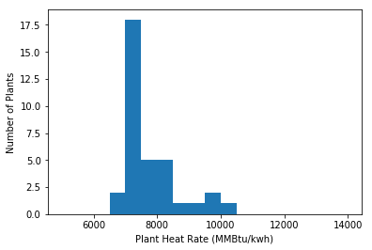
Histogram of ERCOT Heat Rates in 2016

Slide 4
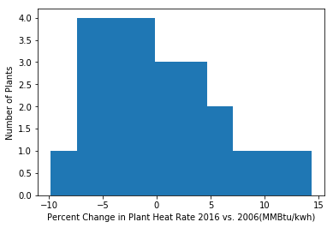
Histogram of Percent Change in Plant Heat Rate: 2016 vs 2006

Slide 5
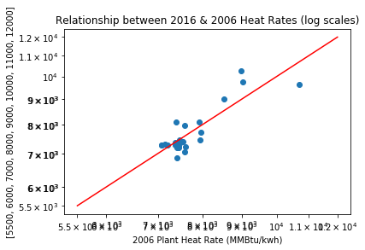
ERCOT CCGT Heat Rates Do Not Appear to Have Increased Systematically Since 2006

Slide 6
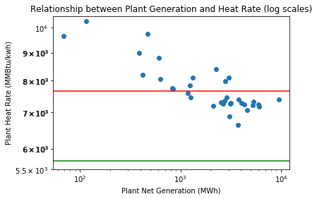
Larger Plants Tend to Have Lower Heat Rates

Slide 7
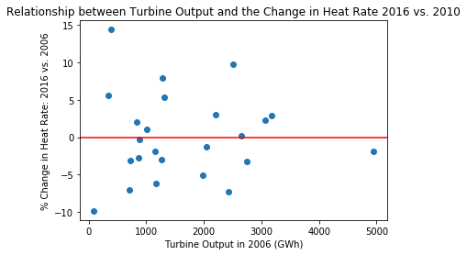
Changes in Plant Heat Rates Appear to be Independent of Plant Size

Slide 8
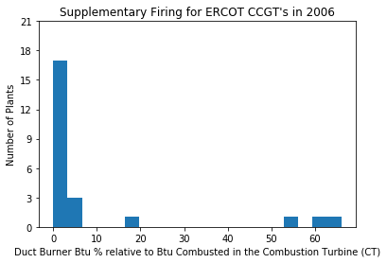
Supplementary Firing is Inefficient, but Allows Plants to Increase their Output Quickly

Slide 9
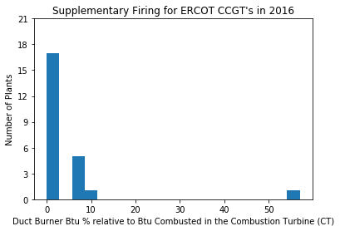
Although Wind has Grown 10x and the Need for Flexible Generation has Increased, Supplementary Firing Appears to have Decreased

Slide 10
Summary of Initial Exploratory Analysis
It is theoretically possible for the Heat Rate of a CCGT to double when required to provide highly flexible generation to back-up intermittent Wind Energy.
Any such material increase would offset the net CO2 reduction benefit of Wind Energy.
However, at ERCOT Wind Energy has increased more than tenfold and Heat Rates appear to have remained essentially unchanged.
Inefficient but flexible Supplementary Firing by CCGT’s might be expected to have increased to accommodate intermittent Wind Generation, but it has not.
No obvious evidence of any inefficiencies associated with the growth in Wind energy (which is verey contrary to German experience, for example).

Slide 11
II. Multivariate Regression Analysis of Plant Heat Rates

Slide 12
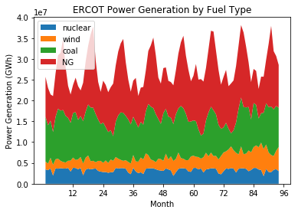
Generation from Coal and Natural Gas Flex to Meet ERCOT’s Substantial Summer Air Conditioning Load

Slide 13
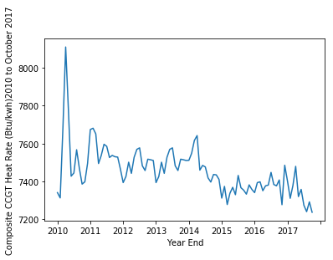
Heat Rates Vary Greatly from Month to Month: The April Spikes are Due to Large Nuclear Plants Offline

Slide 14
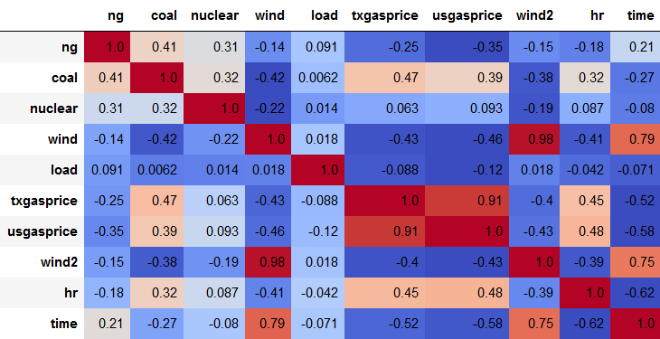
Correlation Matrix: 2010 – 2017 YTD

Slide 15
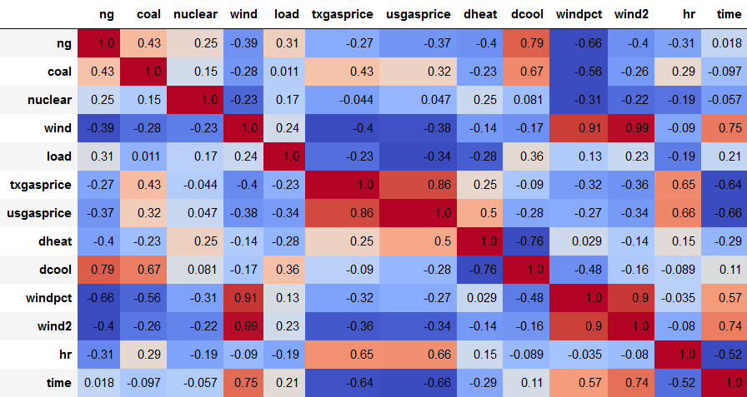
Correlation Matrix since 2014: (includes Heating & Cooling Days)

Slide 16
To Come: groupby month mean

